Slide 1
Testing

Slide 2
Testing – Manual v Automated
Testing is a really important topic
System stability – is the system going to crash or not?
System usability – is the system easy to use?
System security – is the data and code safe from hackers?
Manual testing is...
Time consuming
Tedious
Often left till the end or missed out completely
Automated testing
The first thing you do before writing code
Embedded in the development process
Essential to creating well crafted code

Slide 3
Designing Test Cases
Identify attributes to test
May be found from (to name a few)...
Table columns
Object properties
Function parameters
Needs to be structured
Identify...
Maximum value
Minimum value
Maximum boundaries
Minimum boundaries
Mid range value
Extreme maximum and minimum values
Other tests e.g. Incorrect data types

Slide 4
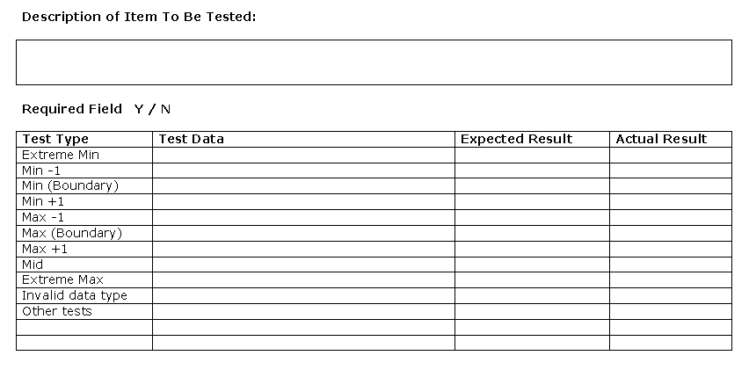
Test Plan

Slide 5
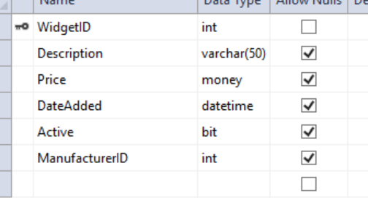
Some Examples

Slide 6
Test Driven Development (TDD)
The rules are…
Create a test that fails
Run the test and see it fail
Fix the error in a simplistic way
See the test pass
Re-factor to implement the feature correctly
Builds confidence in the code we write
Builds confidence in our own ability as developers
Let’s introduce how it works

